Slide 1
Paint or Pixel:
Art in the Age of Artificial Intelligence
MIE1517 Group Project - Team 10

Slide 2
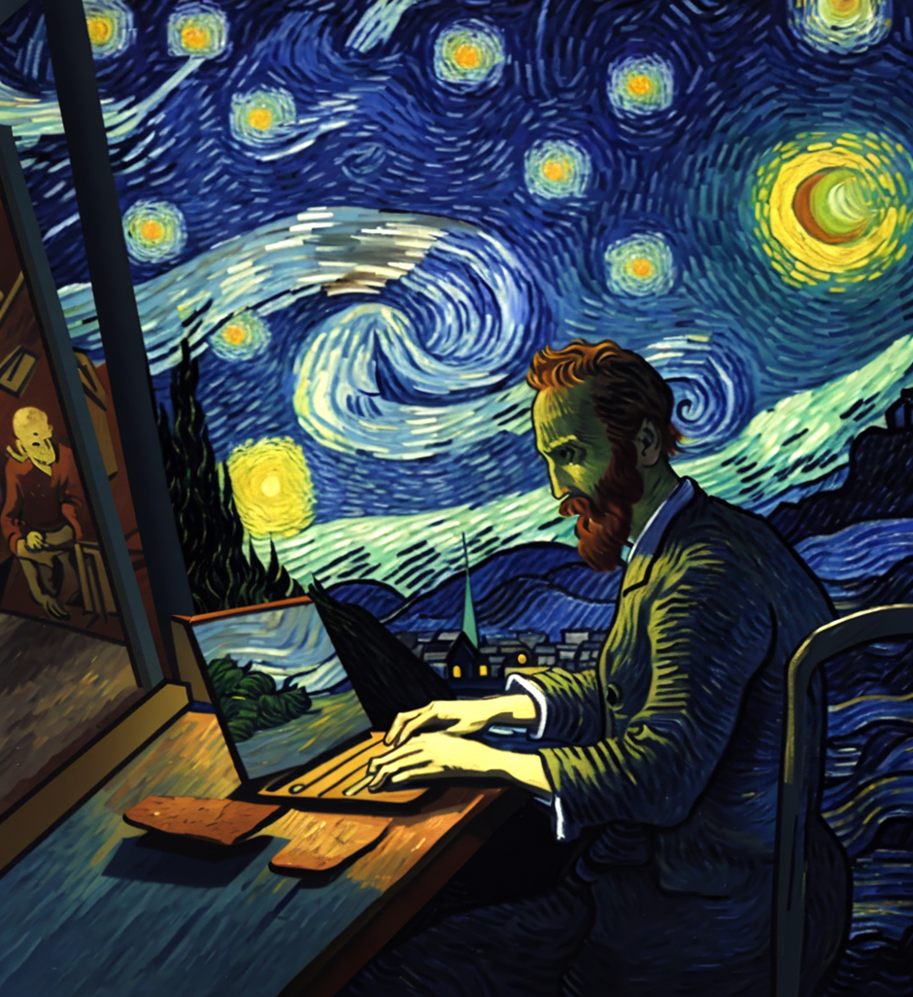
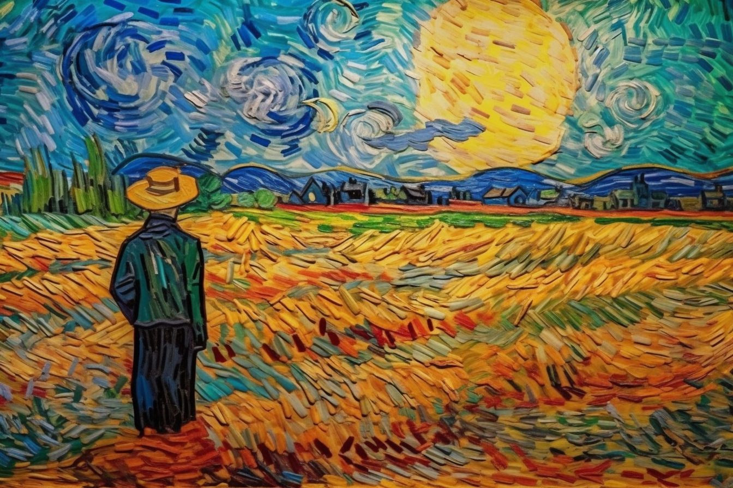
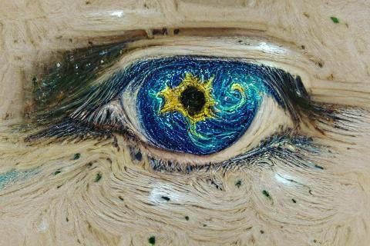
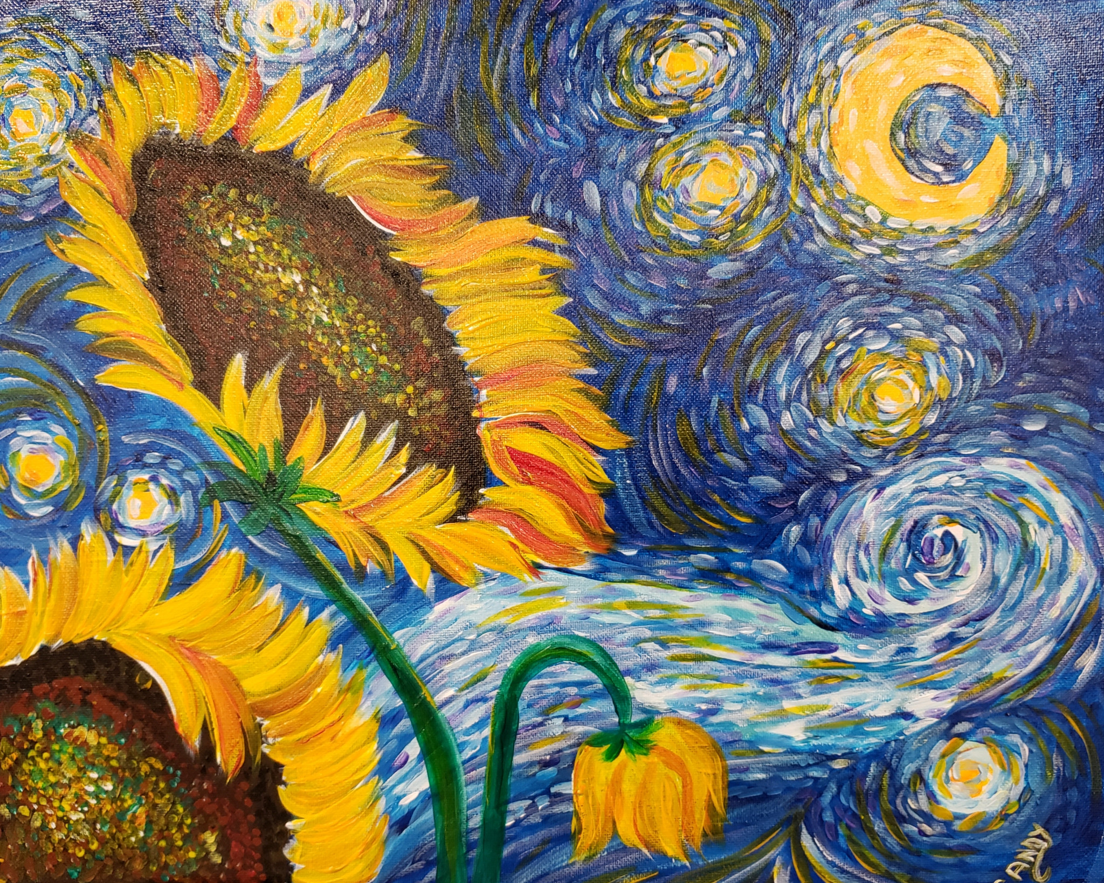
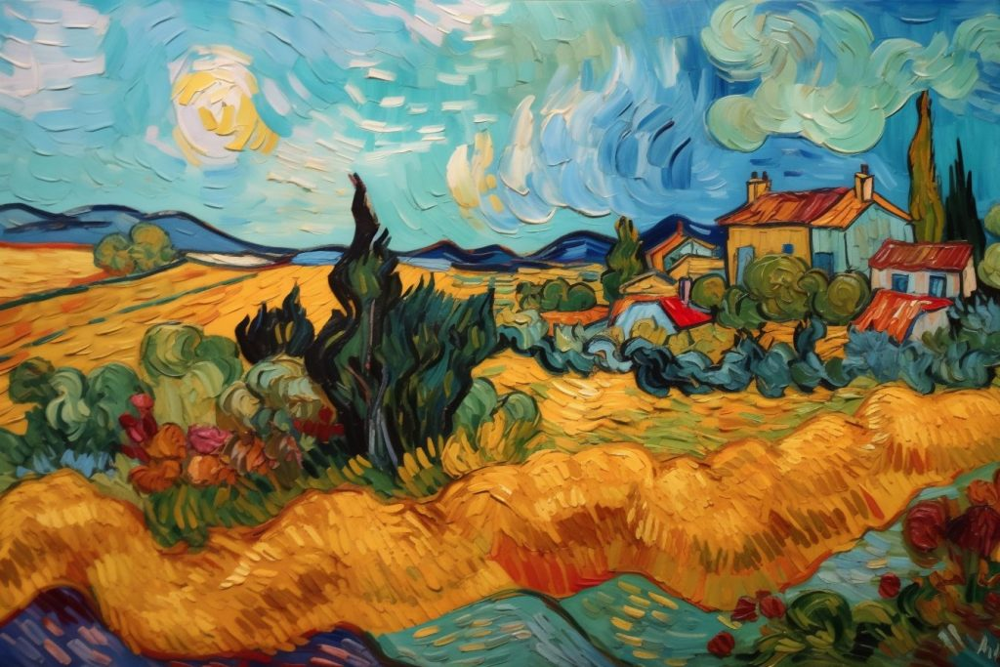

Slide 3
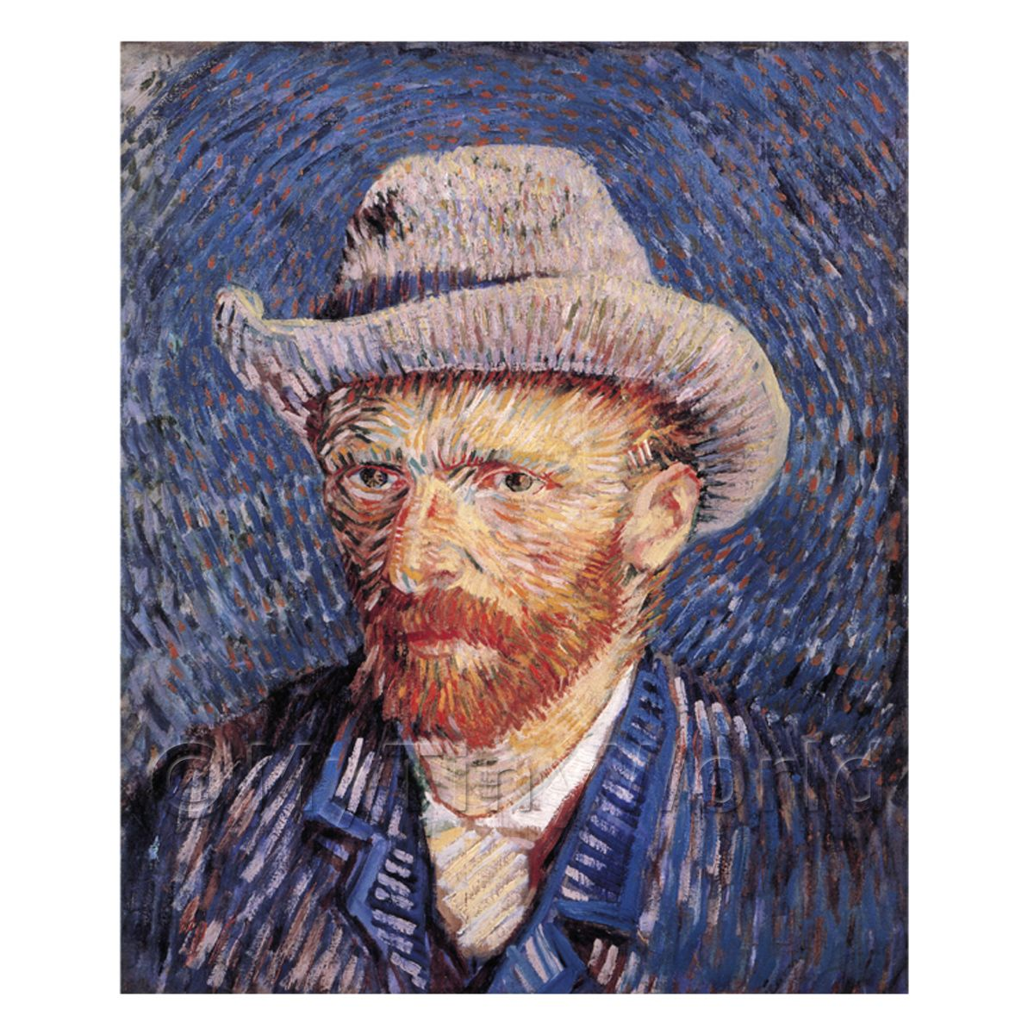
Detailed
Back story
Took forever
Original

Slide 4
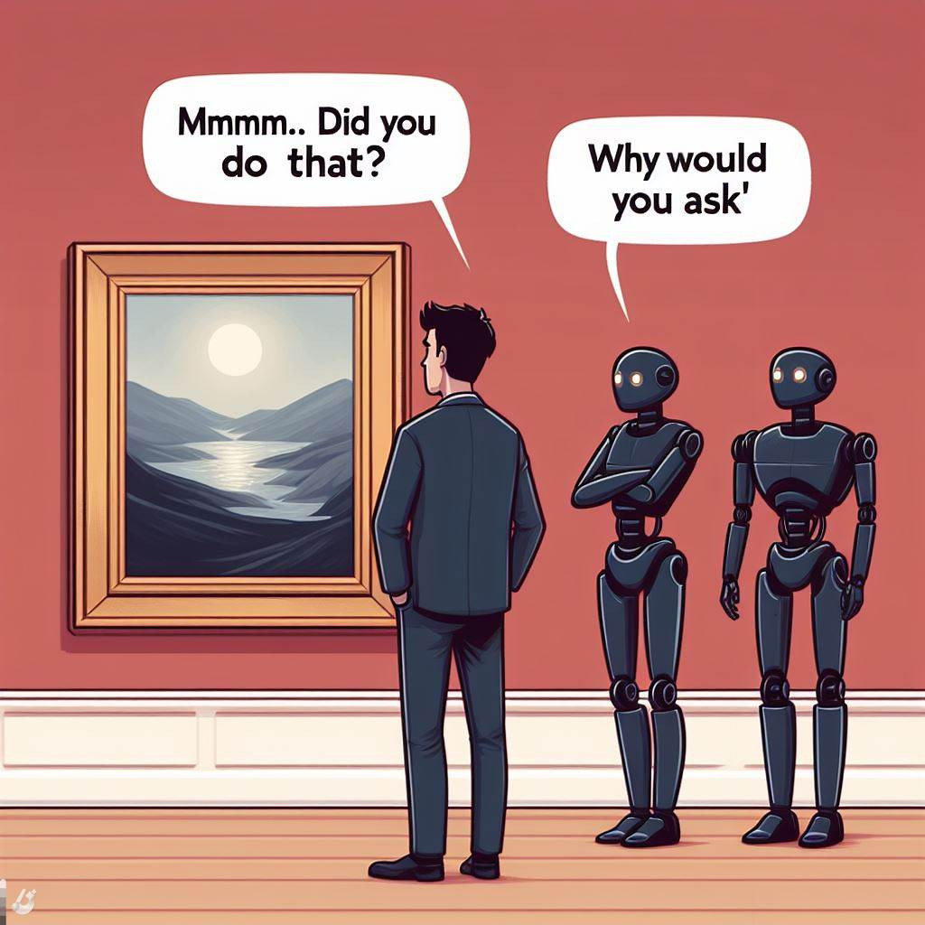
So we’ll ask from AI itself!

Slide 5
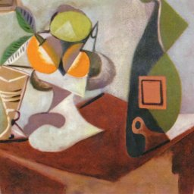
Real or AI?

Slide 6
Real or AI?
Pablo Picasso
Notes:
Wikiart 133

Slide 7
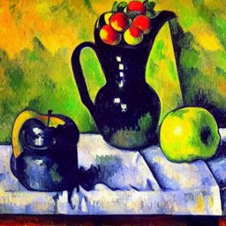
Real or AI?

Slide 8
Real or AI?
Prompt: a gauguinesque, plumping painting of apples and pitcher on table in room with green background by paul cezanne, flickr contest winner, fauvism, fauvism, picasso, painterly
Notes:
Diffusiondb 76

Slide 9
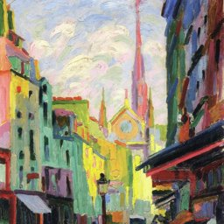
Real or AI?
Notes:
Wikiart 366

Slide 10
Real or AI?
Unknown Artist
Notes:
Wikiart 366

Slide 11
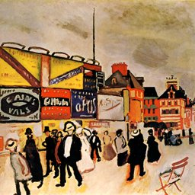
Real or AI?

Slide 12
Real or AI?
Raoul Dufy
Notes:
Wikairt 4562

Slide 13
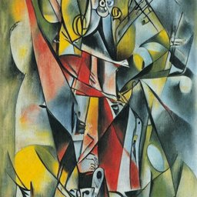
Real or AI?

Slide 14
Real or AI?
Prompt: the fool tarot by roberto matta
Notes:
Diffusiondb 441

Slide 15

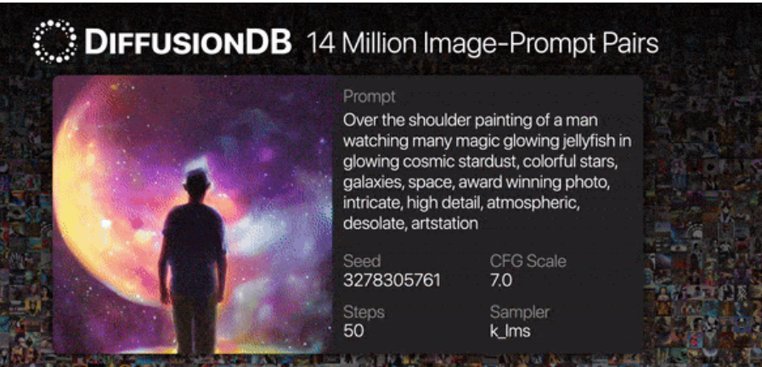
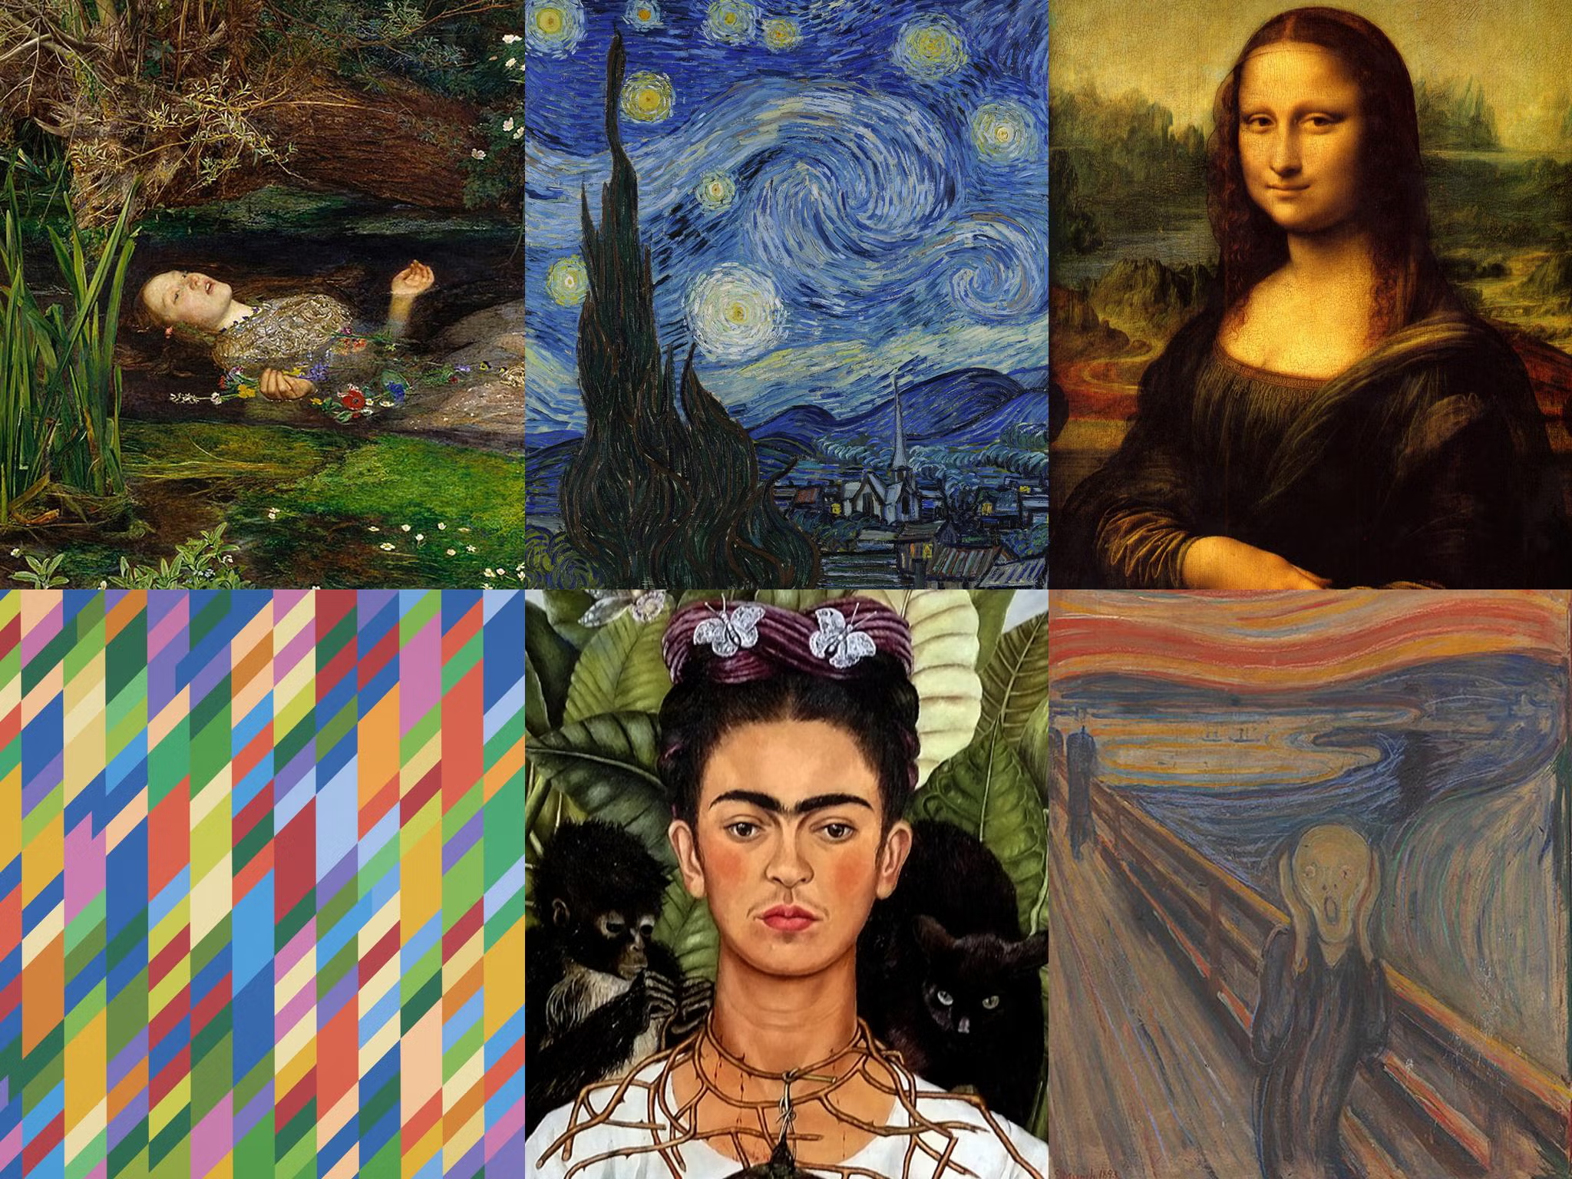
Data Collection
Human Generated Art
AI Generated Art
Notes:
Now, let’s talk about data collection. We sourced these artworks from WikiArt, a well-known and comprehensive online repository of visual art. WikiArt was chosen for its vast and diverse collection, offering a rich dataset of paintings created by human artists across various styles, periods, and genres. Each painting sourced from WikiArt was labeled as 'True', indicating that these are indeed created by human artists. Now, moving on to the AI-generated paintings. These were sourced from DiffusionDB, a database known for its high-quality, AI-generated visual content. These artworks are created using advanced generative models, stable diffusion in this case, presenting a challenging counterpart to the human-created artworks in terms of style and complexity. Similar to the human artworks, each AI-generated painting from DiffusionDB was labeled, but in this case, as 'False'.

Slide 16


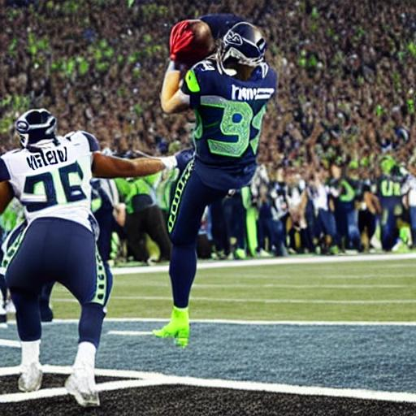
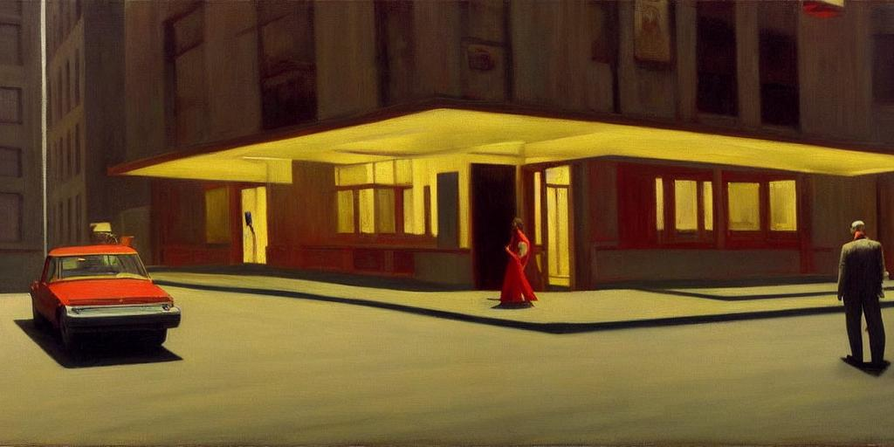
Data Collection - Curation
“iconic stills from david lynch's twin peaks, painting by edward hopper, oil on canvas painting, american realism, highly detailed.”
“seattle seahawks winning the super bowl”
Notes:
Now, let’s talk about data collection. We sourced these artworks from WikiArt, a well-known and comprehensive online repository of visual art. WikiArt was chosen for its vast and diverse collection, offering a rich dataset of paintings created by human artists across various styles, periods, and genres. Each painting sourced from WikiArt was labeled as 'True', indicating that these are indeed created by human artists. Now, moving on to the AI-generated paintings. These were sourced from DiffusionDB, a database known for its high-quality, AI-generated visual content. These artworks are created using advanced generative models, stable diffusion in this case, presenting a challenging counterpart to the human-created artworks in terms of style and complexity. Similar to the human artworks, each AI-generated painting from DiffusionDB was labeled, but in this case, as 'False'.

Slide 17
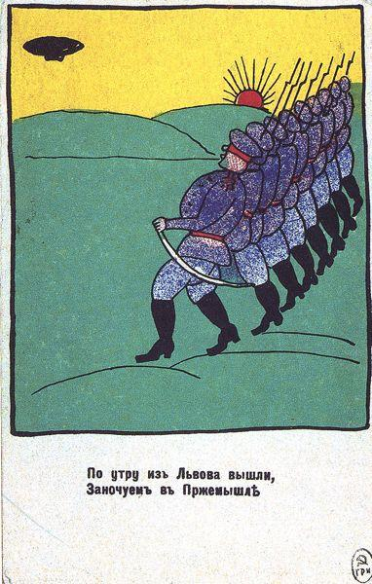
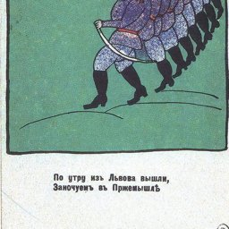
Data Preprocessing
Before
After
256x256
382x600
Notes:
We began by standardizing the format of our images. Given the diverse nature of our dataset, the paintings varied in size and aspect ratio. Our first step was to perform a square crop on each image. Following the cropping, each image was resized to a resolution of 256x256 pixels. This resolution was chosen as a balance between retaining sufficient detail for the CNN to learn the nuances of each painting, and ensuring that the image size was manageable for processing. Next, we standardized the color format of our images. All images were converted to RGB color mode so the CNN can consistently interpret the color information across all images.. Finally, we converted all the images to JPG format. This was done to ensure a uniform file format across our entire dataset

Slide 18
Demo
Please watch video
Notes:
As we move into the most exciting part of our presentation, it’s finally demo time. For this demonstration, we have selected two new images. The first is an artwork generated by ChatGPT-4, a sophisticated AI model known for its capability in various domains, including image generation. The second one is the artwork by a Canadian artist from Calgary.

Slide 19
Performance
Baseline?
Human benchmark (Gangadharbatla, 2022)

Slide 20
Performance
Baseline?
Human benchmark (Gangadharbatla, 2022)
Correctly identified AI-Generated
Correctly identified Human-Generated

Slide 21
Performance
Baseline?
Human benchmark (Gangadharbatla, 2022)
Correctly identified AI-Generated | 43%
Correctly identified Human-Generated | 84%

Slide 22
Performance
Baseline?
Human benchmark (Gangadharbatla, 2022)
Correctly identified AI-Generated | 43%
Correctly identified Human-Generated | 84%
Correctly identified AI-Generated | 43%
Correctly identified Human-Generated | 84%
Overall | 63%

Slide 23
Performance
Humans
Our model (test set)
Correctly identified AI-Generated | 43%
Correctly identified Human-Generated | 84%
Overall | 63%
Correctly identified AI-Generated | 89%
Correctly identified Human-Generated | 84%
Overall | 86.5%

Slide 24
Performance
Humans
Our model (test set)
Correctly identified AI-Generated | 43%
Correctly identified Human-Generated | 84%
Overall | 63%
Correctly identified AI-Generated | 89%
Correctly identified Human-Generated | 84%
Overall | 86.5%
But what did the model really learn?

Slide 25
Analysis: Saliency Maps
Which parts of the input have the most influence on the output?

Slide 26
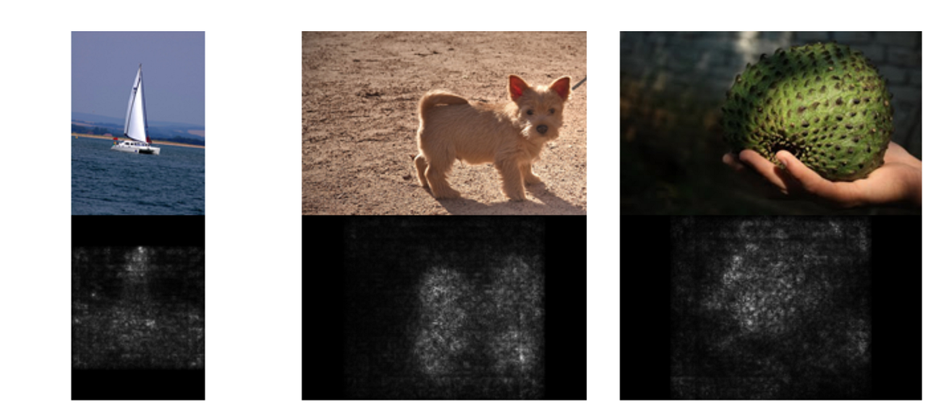
Analysis: Saliency Maps

Slide 27
Analysis : Saliency Maps
Trained Model
“Dog”
Backprop
Input
Input
Output
Output
Gradients
Gradients

Slide 28
Analysis : Saliency Maps
Trained Model
“Dog”
Backprop
“Dog”
Input
Output
Gradients

Slide 29
Analysis : Saliency Maps
Trained Model
“Dog”
Backprop
“Dog”
Input
Input
Output
Output
Gradients
Gradients

Slide 30
Analysis : Saliency Maps
Trained Model
“Dog”
Backprop
“Dog”
Input
Input
Output
Output
Gradients
Gradients

Slide 31
Analysis : Saliency Maps
Trained Model
“Dog”
Backprop
“Dog”
Input
Input
Output
Output
Gradients
Gradients

Slide 32
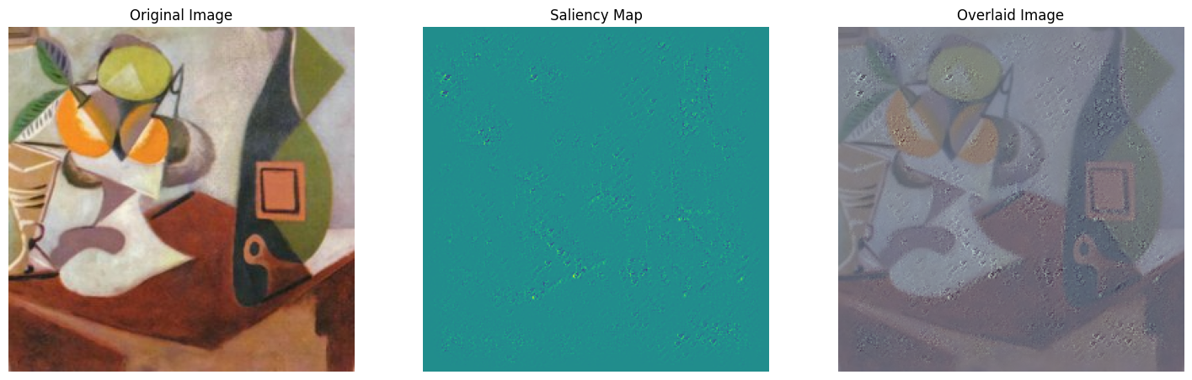
Analysis
Prediction: Human-generated | Confidence: 95.78%

Slide 33
Analysis
Prediction: Human-generated | Confidence: 95.78%

Slide 34
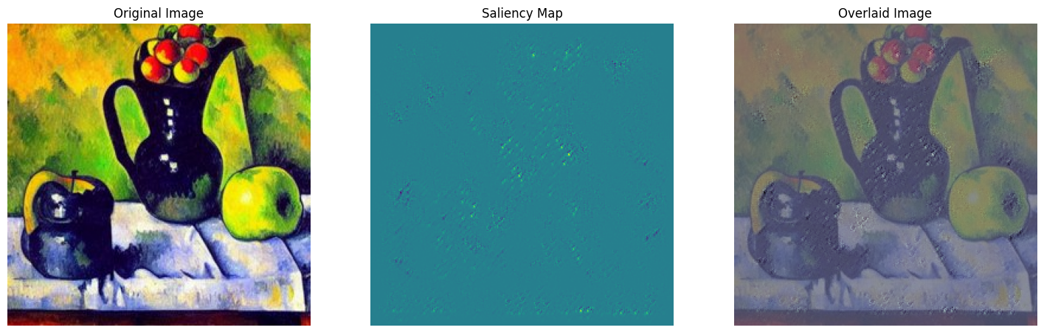
Analysis
Prediction: AI-generated | Confidence: 99.90%

Slide 35
Analysis
Prediction: AI-generated | Confidence: 99.90%

Slide 36
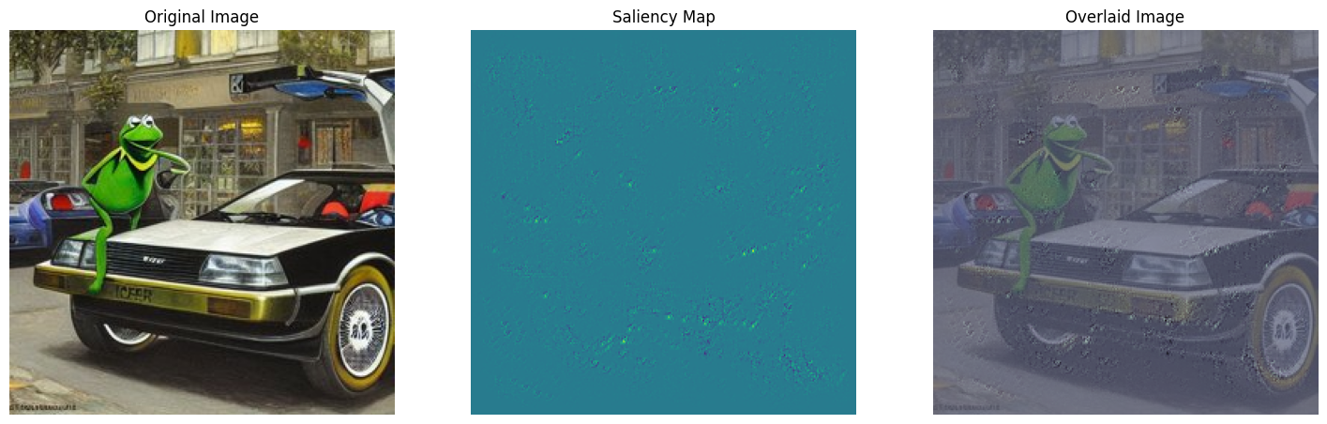
Real or AI?

Slide 37
Real or AI?

Slide 38
Real or AI?

Slide 39
Analysis
Prediction: AI-generated | Confidence: 78.70%

Slide 40
Analysis
How? Explanation

Slide 41
Analysis
How? Explanation
Why? Interpretation

Slide 42
Takeaways
Explainability =/= Interpretability

Slide 43
Takeaways
Explainability =/= Interpretability
Models don’t learn to see the way we do

Slide 44
Takeaways
Explainability =/= Interpretability
Models don’t learn to see the way we do
Solving the problem might be simple, but understanding it is much harder.

